Slide 1

ChatGPT is not all you need.
A State of the Art Review of large Generative AI models
Journal Club, Cem Güleç
January 19, 2023

Slide 2
Outline
Generative AI
Unlocking New Possibilities
The Capabilities of Generative AI
The Power of Generative Models: Data and Architecture
Understanding the Landscape of Generative AI Models
Transformer
Stable Diffusion
Generative AI Models
ChatGPT
Sparrow
MedPalm
AlphaCode
Galactica
Conclusion

Slide 3



Generative AI: Unlocking New Possibilities
Generative AI is unlocking the potential for creating new and unique content, revolutionizing industries and society

Slide 4
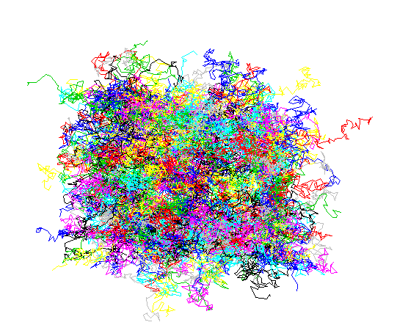
The Power of Generative Models: Data and Architecture
Generative models can process vast amounts of data and sophisticated architecture, making them incredibly powerful tools for creating new and unique content.
With the help of deep neural networks, transformers, and other models like generative adversarial networks and variational autoencoders, these models can understand and process the complexity of data and create new content from it.
Generative models can be trained on large data sets such as the entire Wikipedia, Github, social networks, Google images and more, and still handle the complexity of the data without suffering from underfitting.

Slide 5
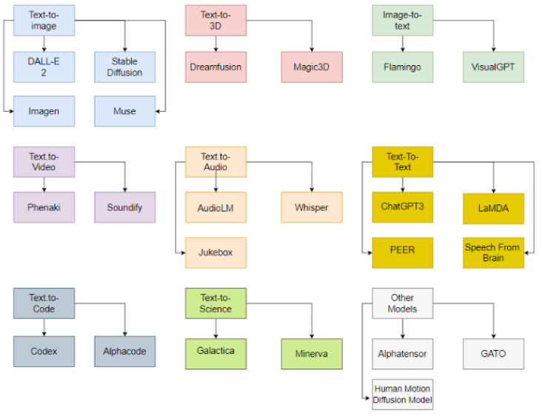
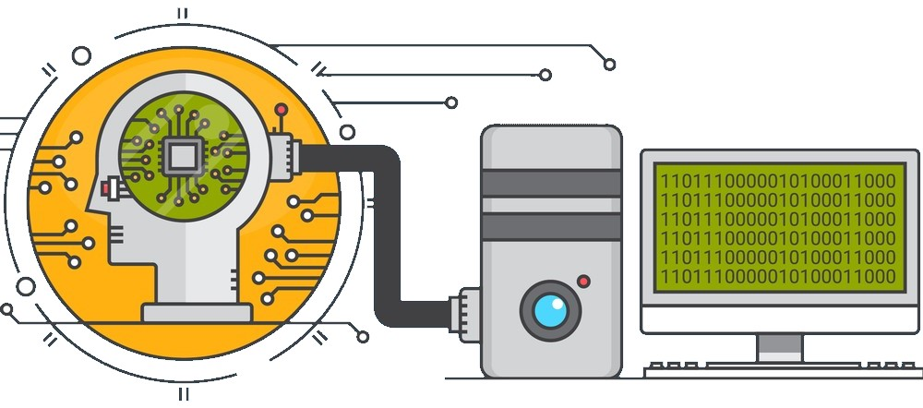
The Capabilities of Generative AI

Slide 6
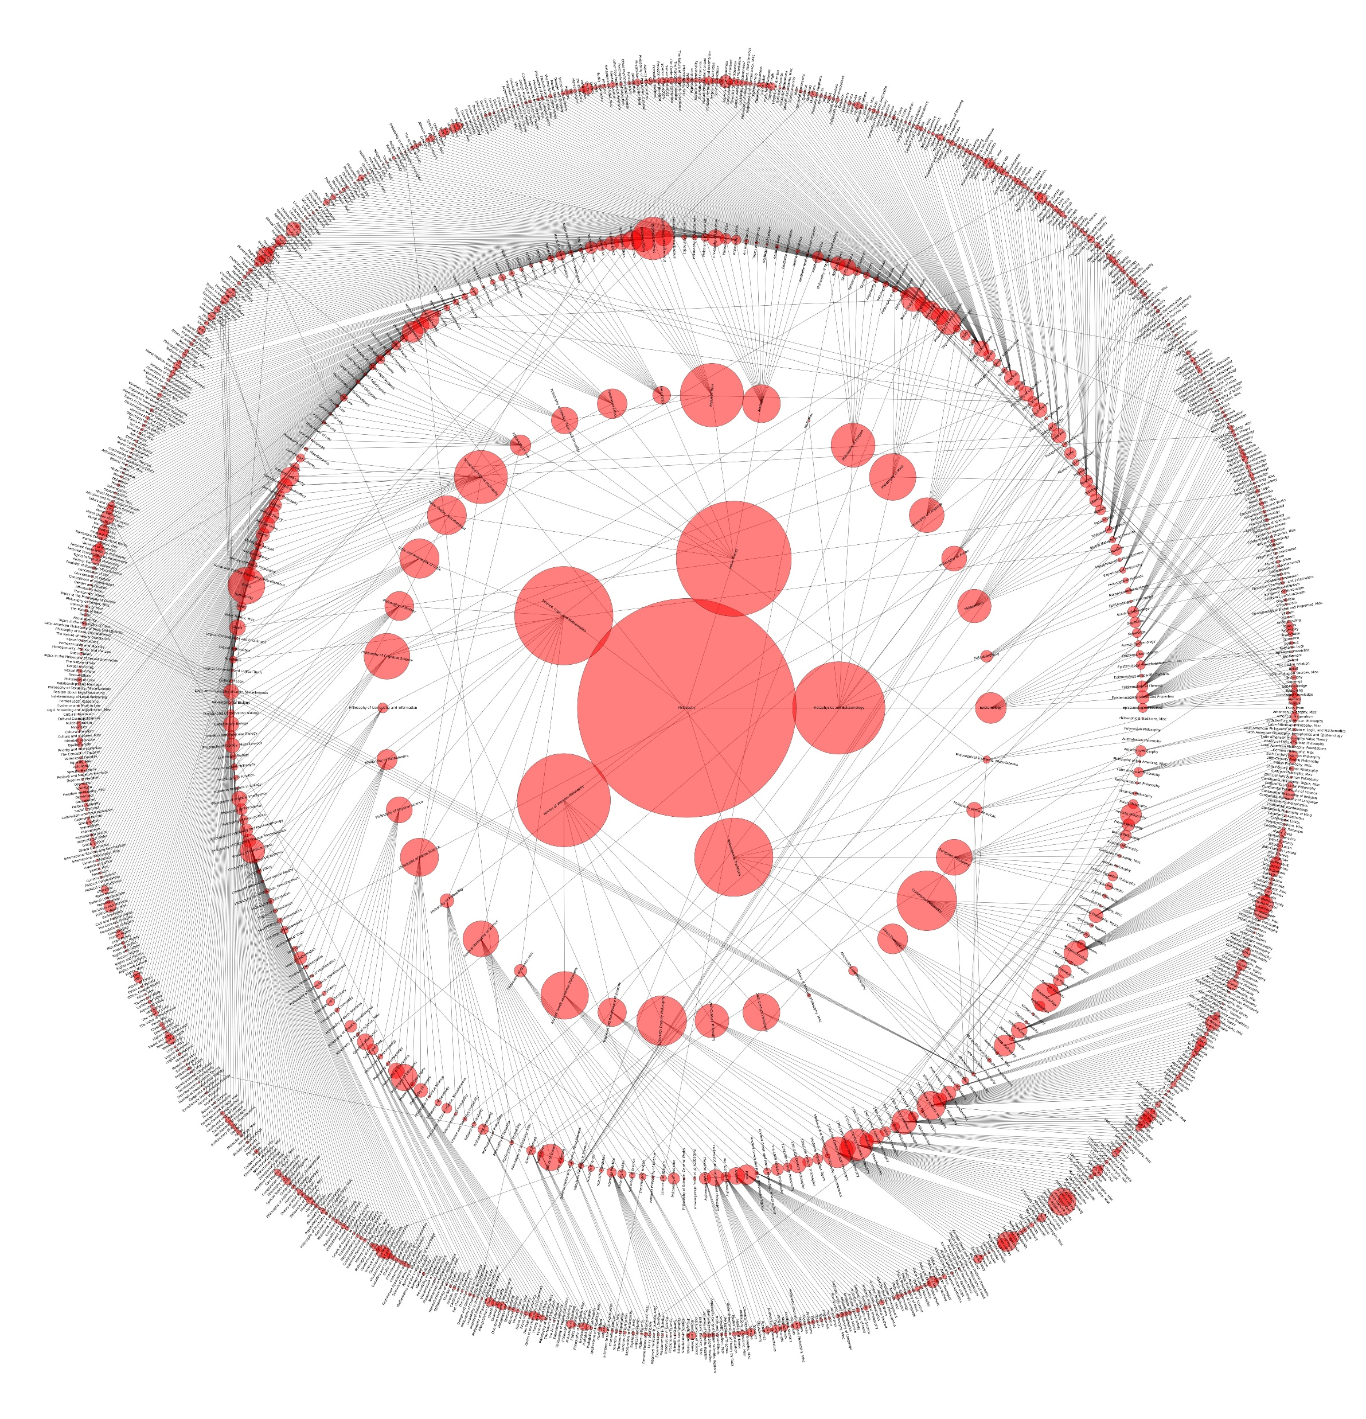
Understanding the Landscape of Generative AI Models
Text-to-3D models
Image-to-Text models
Text-to-Video models
Text-to-Audio models
Text-to-Text models
Text-to-Code models
Text-to-Science models

Slide 7
Generative AI Models Deployment
Only a few organizations are capable of deploying generative AI models
The reasons behind this (e.g., high computation power and expertise required)
The role of acquired startups and collaborations with academia in deployment

Slide 8
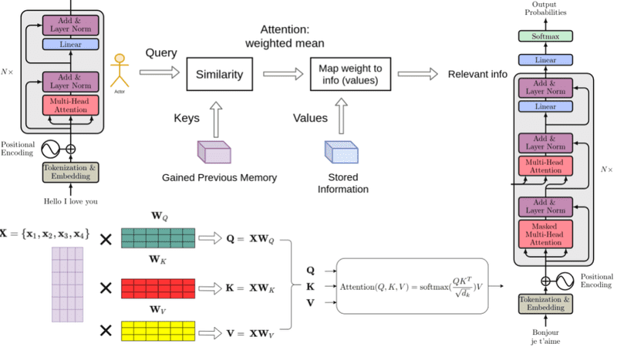
Transformer

Slide 9
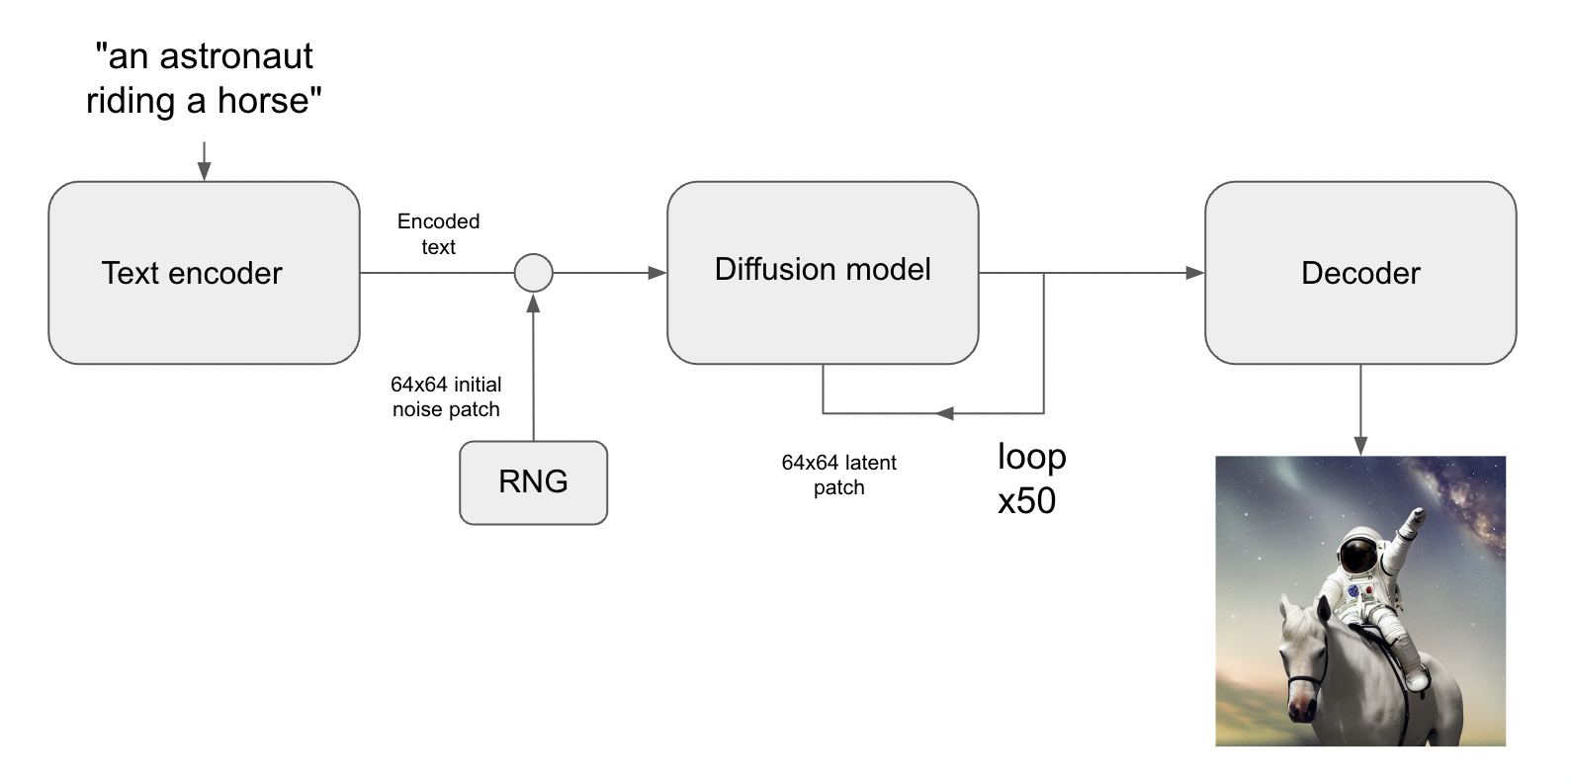
Stable Diffusion

Slide 10

ChatGPT
Could be used to improve the efficiency and accuracy of data annotation, summarization, and report generation tasks.
Could be used to generate hypotheses and explanations for scientific phenomena.
Could be used to generate synthetic data for training and testing other AI models.
A powerful and versatile, could be used for various other tasks and applications.

Slide 11

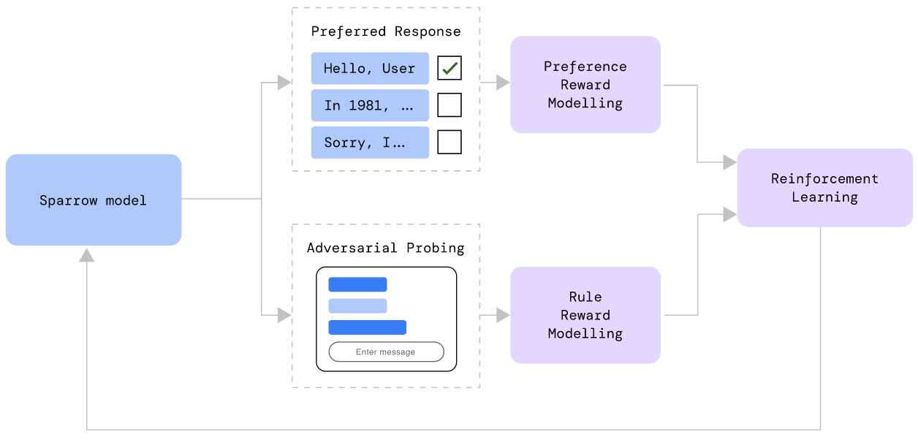
Sparrow

Slide 12

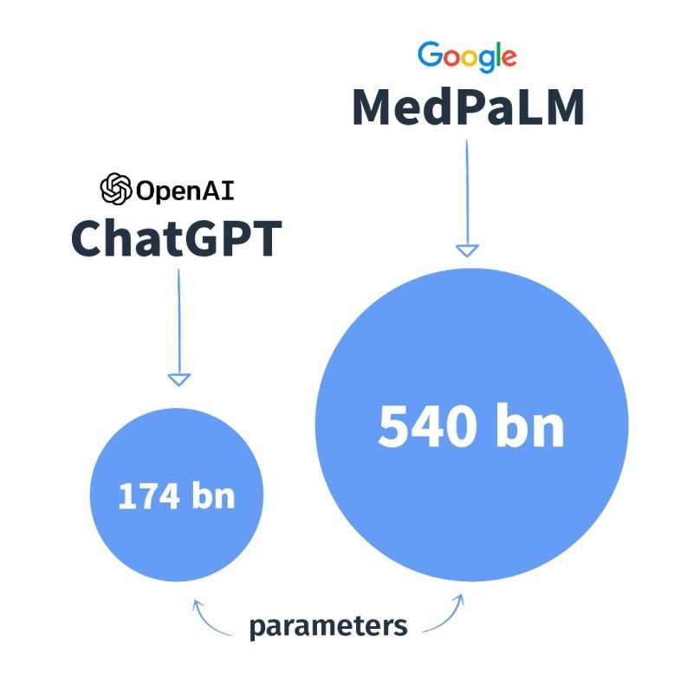
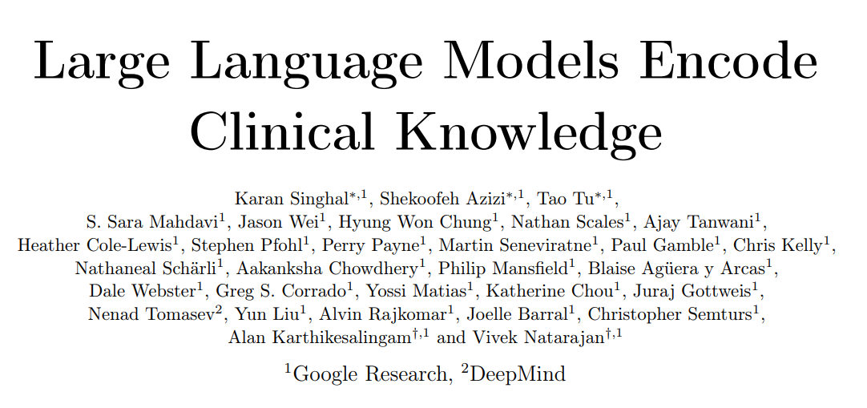
MedPalm

Slide 13

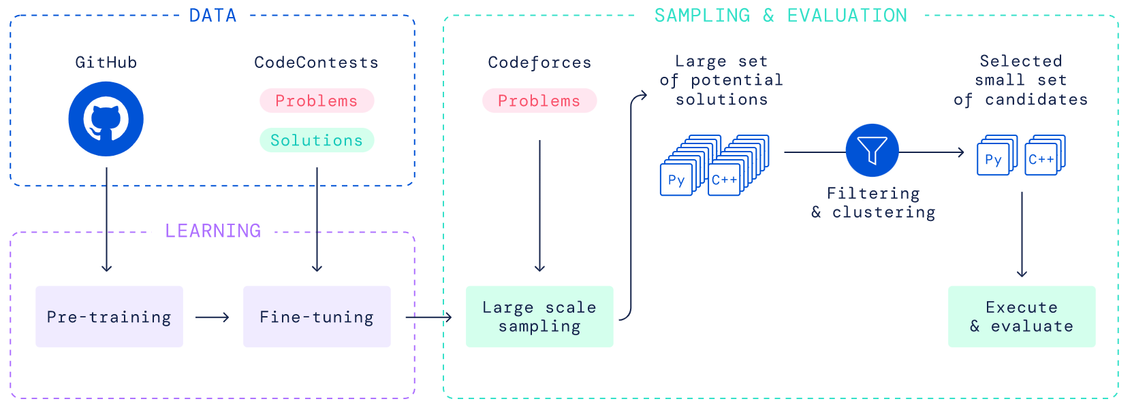
AlphaCode

Slide 14

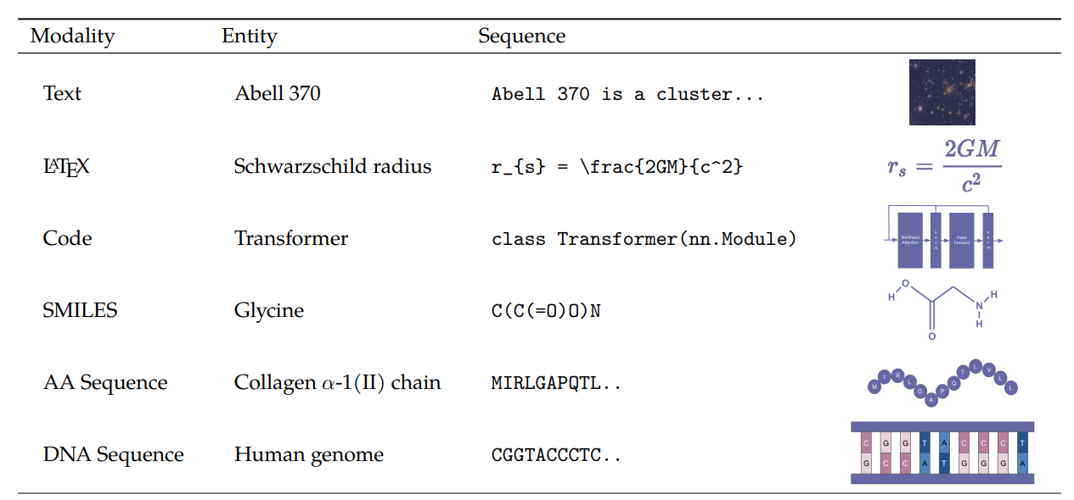
Galactica
Galactica training on text sequences that represent scientific phenomena.

Slide 15
Conclusion
Capabilities:
Creativity and personalization in text-to-image and text-to-audio tasks
Accuracy in text-to-science and text-to-code tasks
Limitations:
Difficulty in finding data for certain tasks
Large dataset and parameter requirements
Difficulty in solving problems outside of the dataset
High computation time and resources needed
Bias issues that need to be controlled

Slide 16
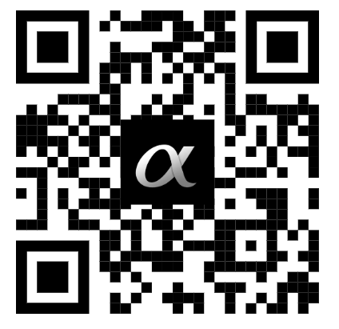
Thank you for listening

